Slide 1


Accessibility: The Road to Success
February 19 – 21

Slide 2


Conference Schedule
February 19 12:00 PM | KEYNOTE: Accessibility: A Civil Right | Vance Martin , University of Illinois Springfield
February 19 2:00 PM | Mapping Your Success: Universal Design for Learning | Zach Petrea, Heartland Community College
February 20 10:00 AM | Simple Solutions: Accessibility for Audio and Video Resources | Robin Fisch, Sauk Valley Community College Lori Wendt, Parkland College
February 20 2:00 PM | Moving Down the Road to Success: How to Approach Accessibility | Kona Jones, Richland Community College Scott Rial, College of Lake County Susan Nugent, Lake Land College
February 21 10:00 AM | Moving Down the Road to Success: How Different Learning Management Systems Address Accessibility | Kona Jones, Richland Community College Selom Assignon, Harold Washington College Lara Tompkins, College of DuPage
February 21 2:00 PM | Digital Access and YOU | Becky Benkert & Mike Maxse, College of DuPage

Slide 3
Conference Archives
Recordings of these presentations will be available at:
http://www.ilcco.net/
under Resources & Events
For more information about ILCCO:
jeff.newell@illinois.gov

Slide 4
Accessibility: A civil right
Growing Online Learning Conference Keynote 2019
Vance S. Martin, PhD
University of Illinois Springfield

Slide 5
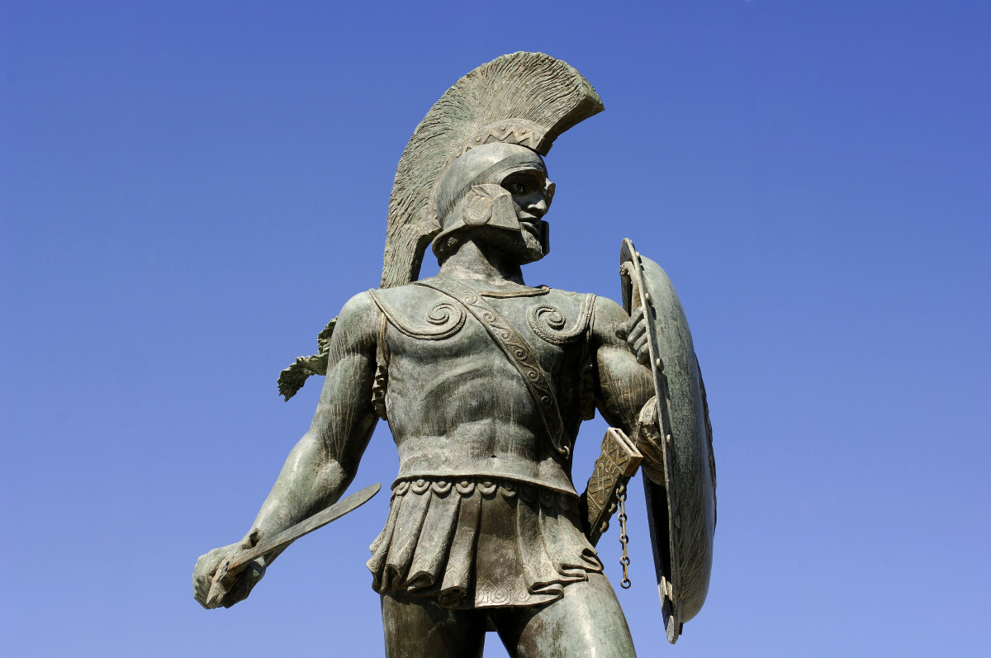
Background and History - Sparta
Notes:
Statue of Spartan soldier against blue sky

Slide 6
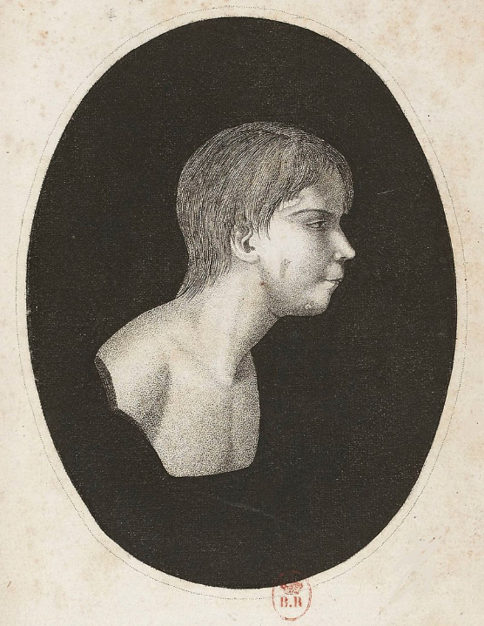
Wild boy “Victor” of Aveyron 1800
Notes:
Drawing of victor of aveyron
Jean Marc Gaspard Itard tried to train or rehabilitate him as might be done with people with disabilities until the industrial revolution

Slide 7
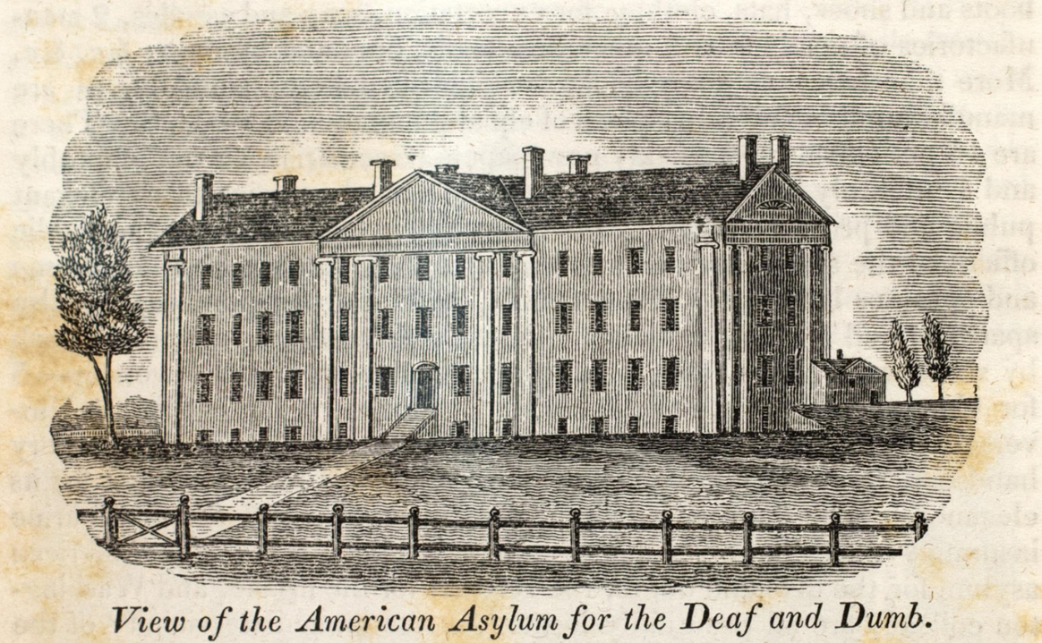
Connecticut Asylum for the Education of Deaf and Dumb Persons 1817
Notes:
drawing of neoclassical mansion in pastoral setting. Text under image "view of the american asylum for the deaf and dumb"

Slide 8
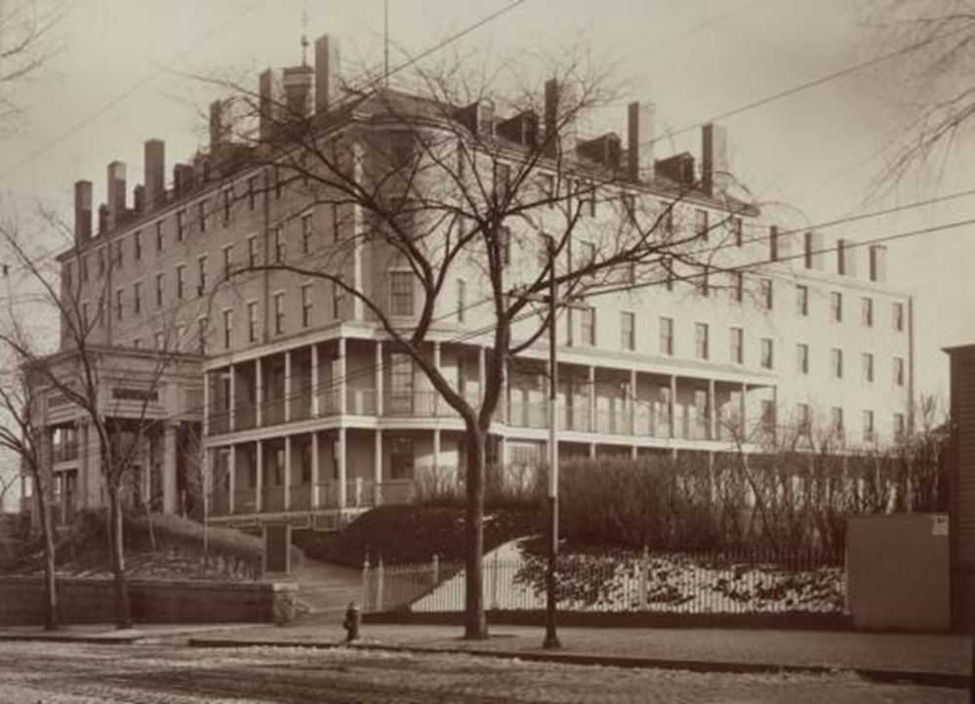
Perkins Institute for the Blind 1832
Notes:
5 story beaux arts building, originally a hotel which housed the Perkins school in south boston

Slide 9
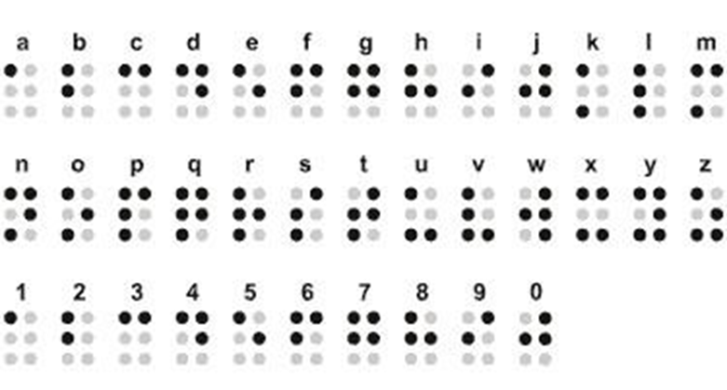
Braille Published 1834
Notes:
a through z and 1 through 0 in braille

Slide 10
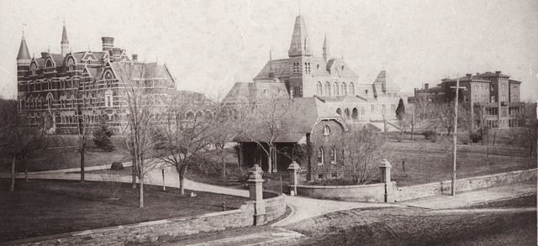
National Deaf Mute College
(Gallaudet University) 1864
Notes:
Photo from 1860s showing Gallaudet campus with only 4 buildiongs

Slide 11
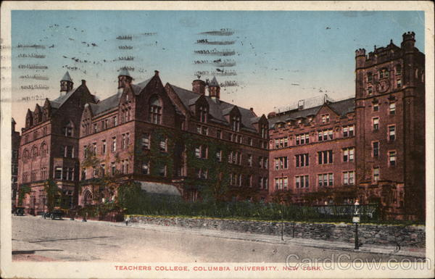
Teacher training for teachers of the blind 1884 Columbia Teachers College
Notes:
Exterior of gothic building which houses Columbia teachers college

Slide 12

Industrialization changes view on disability
Notes:
Image of factory floor from 1850’s showing many women packed in room with machines
In this period education changes as does place of people with disabilities in a non rural, industrial world which requires people to be able to do specific, fine motor skills, minor reading to use machines

Slide 13
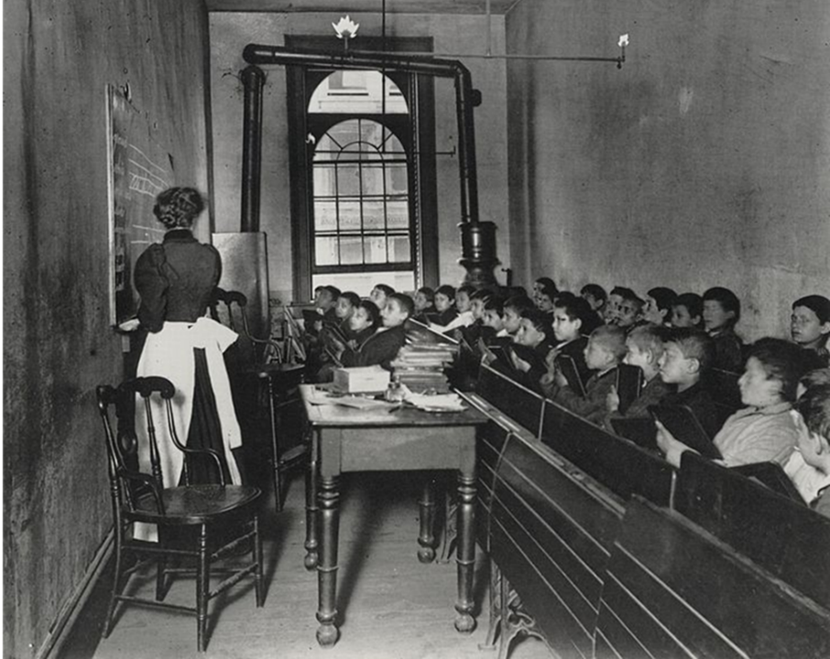
Education industrialized and supportive of industry
Notes:
crowded classroom with teacher in front c 1850

Slide 14

Control the problem
Notes:
the cover of a book called social control of the mentally deficient from around 1900

Slide 15
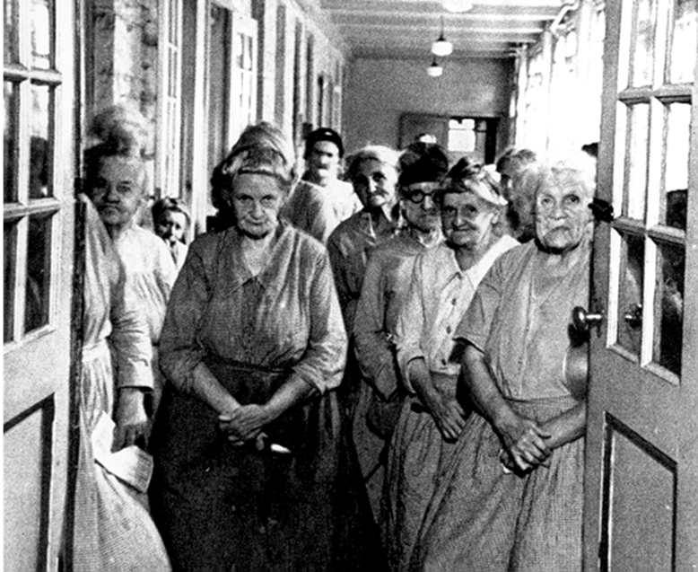
Hide the problem
Notes:
Older women housed in a state institution c 1900

Slide 16
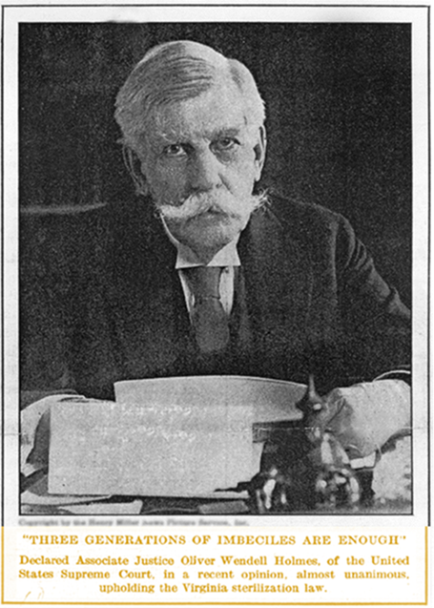
Eugenics: American Made 1907
62,162 sterilizations
Notes:
Image of Supreme Court Justice Oliver Wendell Holmes, with a quote “three generations of imbeciles is enough, declared associate justice Oliver Wendell Holmes of the United States Supreme Court in a recent opinion, almost unanimous upholding the Virginia sterilization law of 1924

Slide 17
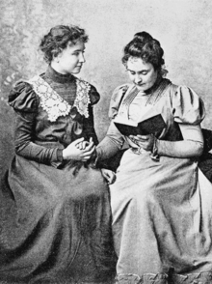
Helen Keller
Notes:
Image of helen keller with anne sullivan
1890-1968, campaigned for women’s suffrage, labor rights, socialism, pacifism, and helped found aclu

Slide 18
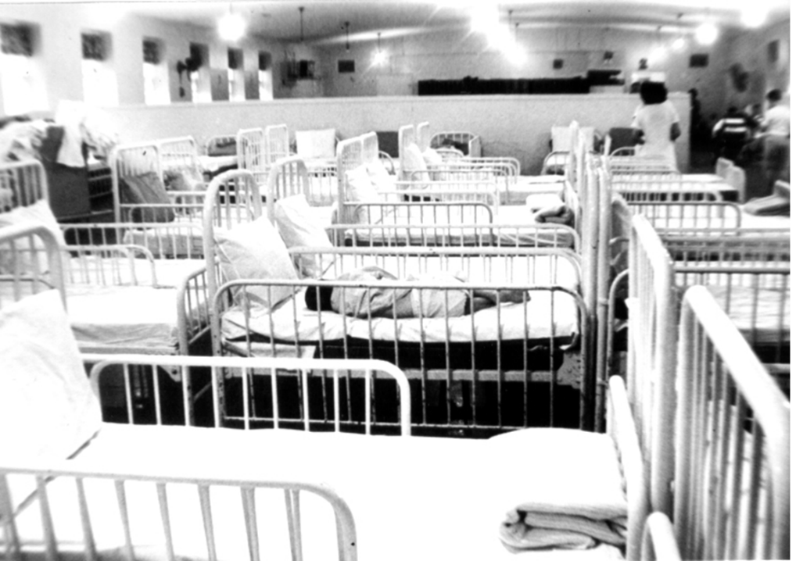
Equality?
Notes:
room stuffed with adult sized cribs or hospital beds filled with people with disabilities

Slide 19
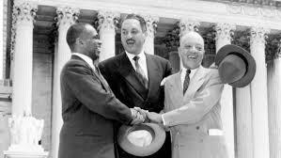
Brown v Board 1954
Notes:
Thurgood marshall selbrating outside supreme court after verdict of brown v board

Slide 20
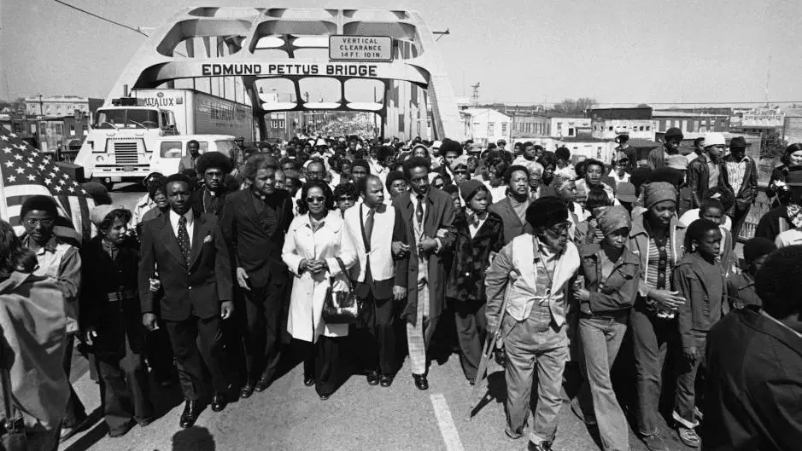
African American protests
Notes:
people protesting for equal right for all in Mississippi on petus bridge

Slide 21
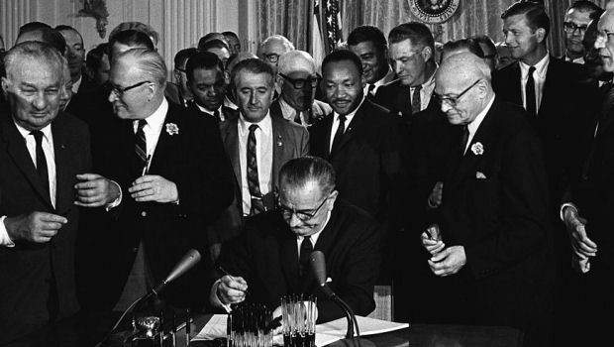
Civil Right Act 1964
Notes:
LBJ signing civil rights act with MLK behind him

Slide 22
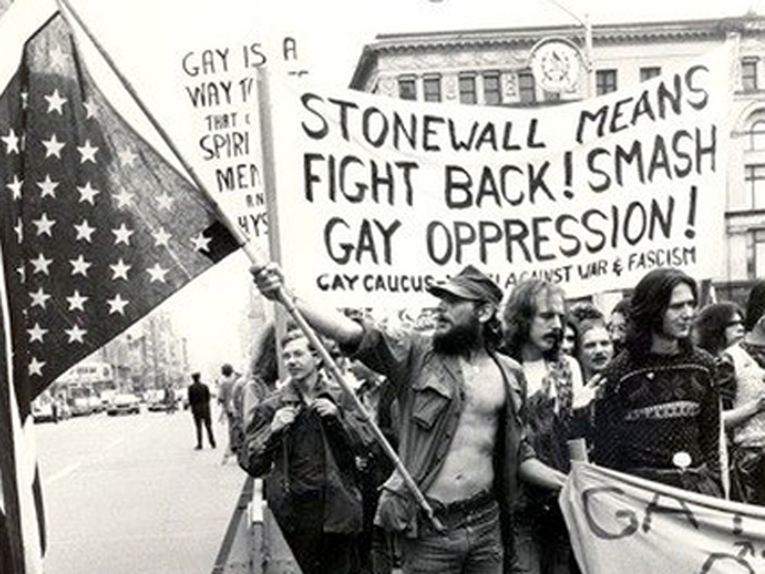
LGBT Protests
Notes:
LGBT protestors holding sign “stonewall means fight back smash gay oppression”

Slide 23
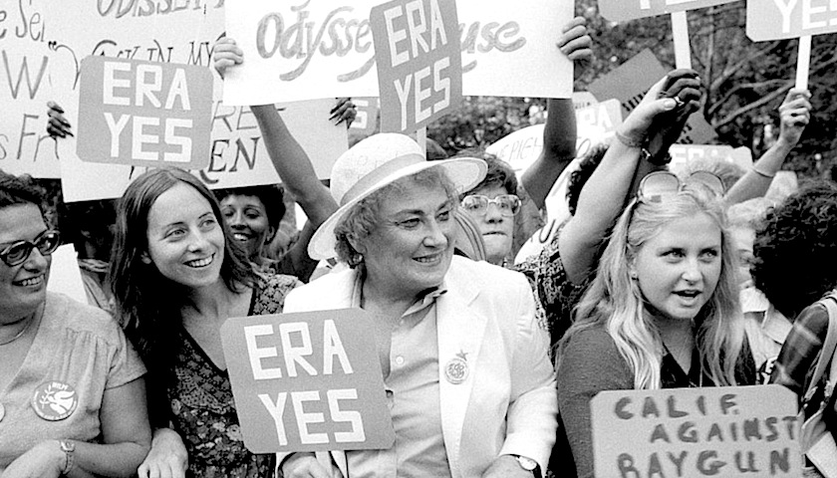
Protests for ERA
Notes:
Women protesting for era in lat 1970s california

Slide 24
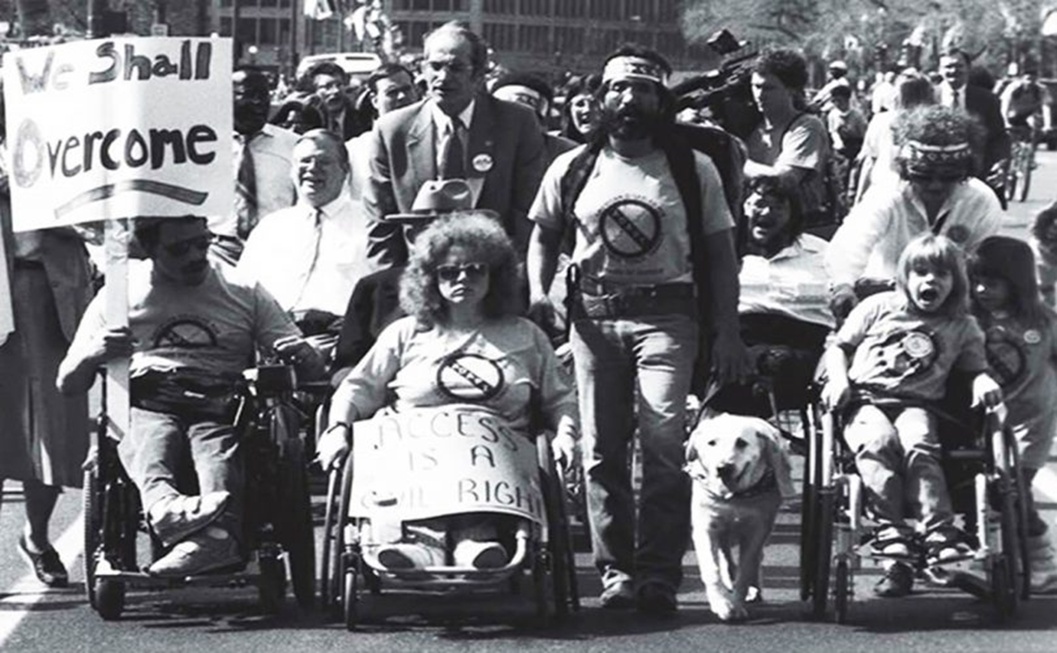
Forgotten protesters
Notes:
People with varied disabilities protesting for equal rights

Slide 25
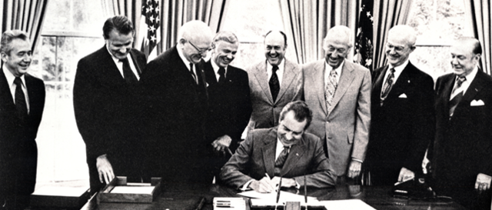
Rehabilitation Act 1973
Notes:
Nixon signing rehabilitation act of 1973

Slide 26
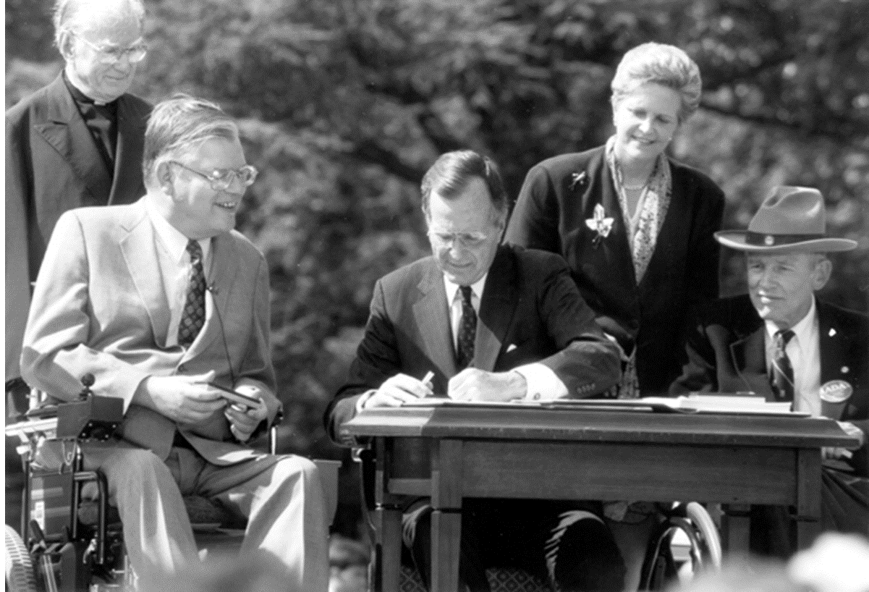
Americans with Disabilities Act 1990
Notes:
a man in a wheel chair next to president George HW Bush as he signs the ADA

Slide 27
Laws
1954- Brown v Board “separate cannot be equal”
1964- Civil Rights Act
1973- Rehabilitation Act (Public)
  Section 504 of Rehabilitation Act focuses on equality in education
    Job training
    Access to building and transport
    Protection for people with disabilities
1986- Section 508 Electronic and IT must be accessible
1990- Americans with Disabilities Act (extends 504 to Private)
1998- Section 508 refresh
1999- WCAG 1.0
2008- WCAG 2.0
2010- CVAA (Communications and Video Accessibility Act) commercial video
2017- 508 refresh
Notes:
Remember learning, cognitive, physical

Slide 28
Case Laws
2000
  North Carolina State sued over inaccessible hardware and software.
2009
  Small Business Association sued over inaccessible website.
  Social Security Administration sued over inaccessible website.
  United States Department of Education sued over inaccessible website and documents.
  The Ohio State University sued over failure to caption video at the Stadium and Arenas.
  Arizona State University sued over use of inaccessible Amazon Kindles.
  Pace University sued over use of inaccessible Amazon Kindles.
  Case Western sued over use of inaccessible Amazon Kindles.
  Reed College sued over use of inaccessible Amazon Kindles.
  University of Virginia Darden School of Business sued over use of inaccessible Amazon Kindles.
2010
  Netflix sued over non-captioned streaming videos.
  Penn State sued over inaccessible websites, learning management system, smart podiums, banks software and ATMs.
  McNeese State University sued over inaccessible buildings.
2011
  Florida State sued over inaccessible software, textbooks, and clickers.
  University of California Berkeley sued over inaccessible textbooks.
  Northwestern University sued over use of inaccessible Google apps.
  New York University sued over use of inaccessible Google apps.
  South Carolina Technical College System sued over inaccessible websites.
2012
  Maricopa Community College sued over inaccessible course materials.
  University of Kentucky sued over failure to caption video at the Stadium and Arenas.
  University of Montana sued over inaccessible learning management system, clickers, and websites.
2013
  University of California Berkeley sued over failure to caption videos, inaccessible Massive Open Online Courses, and for shorter time in making course materials accessible.
  University of Maryland sued over failure to caption video at the Stadium and Arenas.
2014
  Miami University sued over inaccessible course materials.
  Mt Hood Community College sued over inaccessible websites.
  University of Cincinnati sued over inaccessible websites.
  University of Colorado Boulder sued over inaccessible websites, learning managements systems, and course materials.
  Youngstown State sued over inaccessible websites.
2015
  Amazon sued over failure to caption streaming videos.
  Atlantic Cape Community College sued over inaccessible books, labs, and websites.
  Massachusetts Institute of Technology and Harvard University sued over non-captioned videos.
  Siskiyou Joint Community College sued over inaccessible materials.
  University of Phoenix sued over inaccessible learning management system.
2016
  Hulu sued over failure to caption streaming videos.
  College of Westchester sued over inaccessible websites.
  Iona College sued over inaccessible websites.
  Netflix sued over failure to have have narrated audio descriptions.
2017
  Los Angeles Community College District sued over inaccessible instructional materials.
  Fordham University sued over inaccessible websites.

Slide 29

How people access technology
Notes:
Image of mac keyboard with blue access button

Slide 30

Adaptive keyboard
Notes:
Adaptive keyboard

Slide 31

Refreshable Braille Display
Notes:
Refreshable braille display

Slide 32

Oversized trackball
Notes:
Oversized trackball

Slide 33
Voice recognition software
Apple
Google
Microsoft
Dragon
Amazon

Slide 34
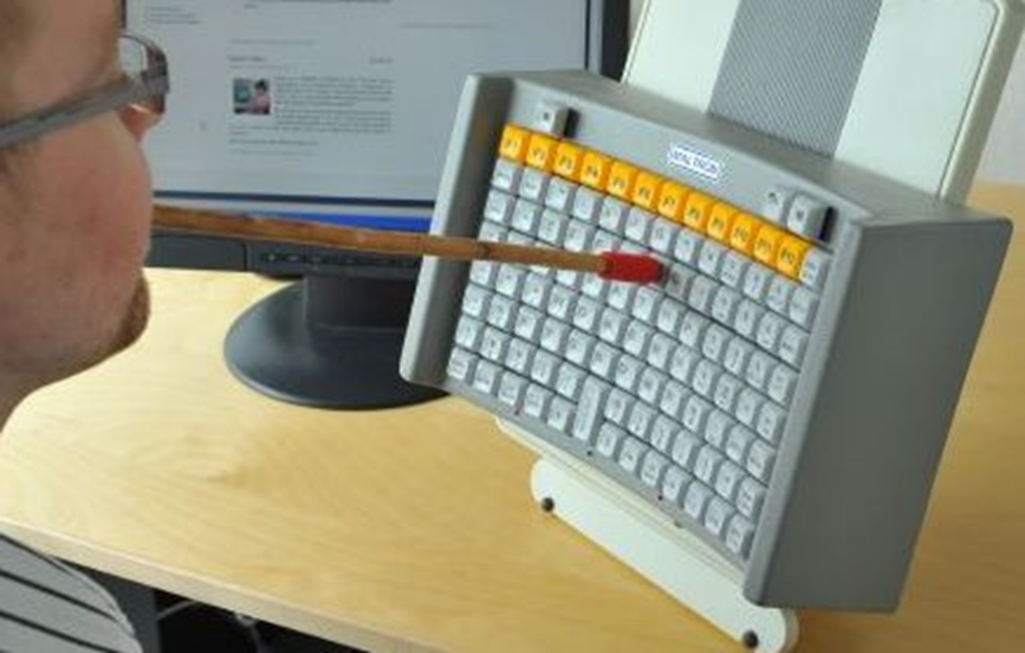
Mouth Stick
Notes:
Mouth stick in use

Slide 35
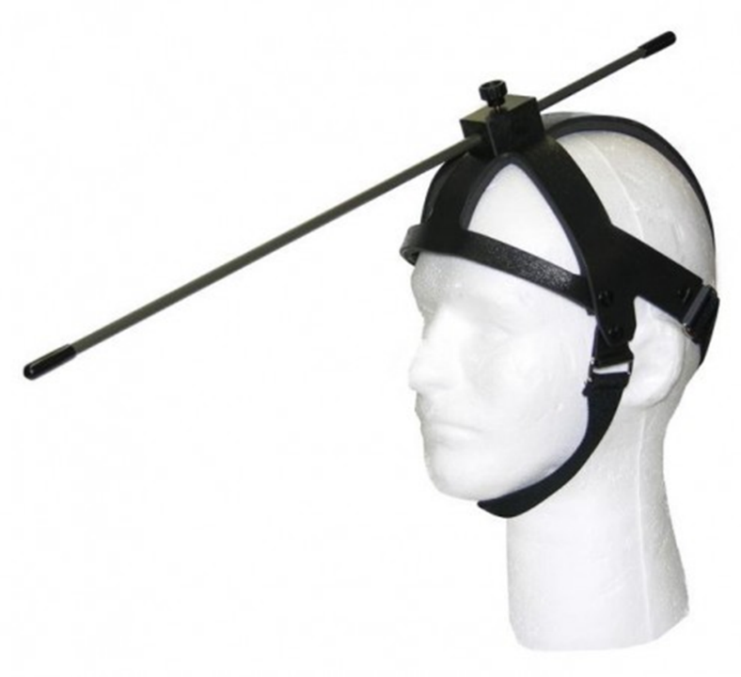
Headwand
Notes:
Headwand on mannequin

Slide 36

Single switch access
Notes:
4 colorful single switches

Slide 37
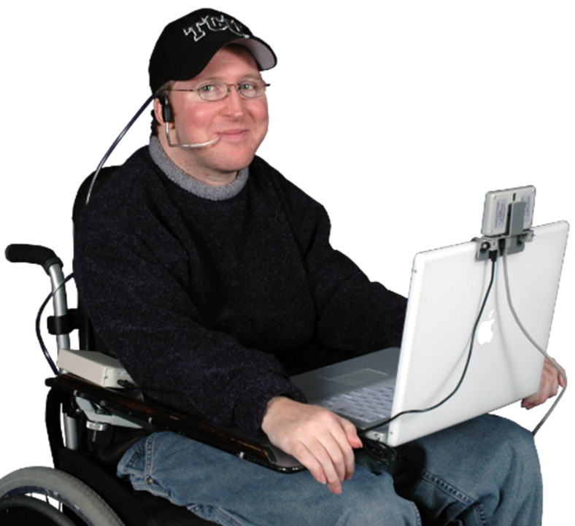
Sip and puff
Notes:
Man with laptop and sip and puff on head

Slide 38
Links
Eye tracking video
Screen reader sample

Slide 39

Where does this leave us?
Notes:
Map with question marks

Slide 40
U.S. Demographics
60.7% White
50.8% Female
25% Disability
18.1% Latino
13.4% African-American
5.8% Asian
2.7% Multiracial
1.3% Native American
.2% Pacific Islander

Slide 41
What can you do?
Make future Word and PowerPoint documents accessible
Limit use of PDFs
Plan for audio descriptions in videos
Caption videos and provide transcripts

Slide 42
Final thought
As technology is ubiquitous, it is patently unfair to not make the information accessible for 25% of the population

Slide 43
Questions?
Contact me:
vmart02s@uis.edu

Slide 44
Conference Schedule
February 19 12:00 PM | KEYNOTE: Accessibility: A Civil Right | Vance Martin , University of Illinois Springfield
February 19 2:00 PM | Mapping Your Success: Universal Design for Learning | Zach Petrea, Heartland Community College
February 20 10:00 AM | Simple Solutions: Accessibility for Audio and Video Resources | Robin Fisch, Sauk Valley Community College Lori Wendt, Parkland College
February 20 2:00 PM | Moving Down the Road to Success: How to Approach Accessibility | Kona Jones, Richland Community College Scott Rial, College of Lake County Susan Nugent, Lake Land College
February 21 10:00 AM | Moving Down the Road to Success: How Different Learning Management Systems Address Accessibility | Kona Jones, Richland Community College Selom Assignon, Harold Washington College Lara Tompkins, College of DuPage
February 21 2:00 PM | Digital Access and YOU | Becky Benkert & Mike Maxse, College of DuPage

Slide 45
Conference Archives
Recordings of these presentations will be available at:
http://www.ilcco.net/
under Resources & Events
For more information about ILCCO:
jeff.newell@illinois.gov

